Slide 1

FACULTY OF INFORMATION TECHNOLOGY
Fall,20172017
MAT 207- LINEAR ALGEBRA
Lecture 6 – Vector Space
21/10/2017
Lecture 3 : Matrix Algebra
1

Slide 2
Content
1
Coordinate Systems
2
The Dimension of a Vector Space
3
Rank
4
Change Of Basis
21/10/2017
Lecture 2 : Linear Equation in Linear Algebra
2

Slide 3
Coordinate Systems

Slide 4
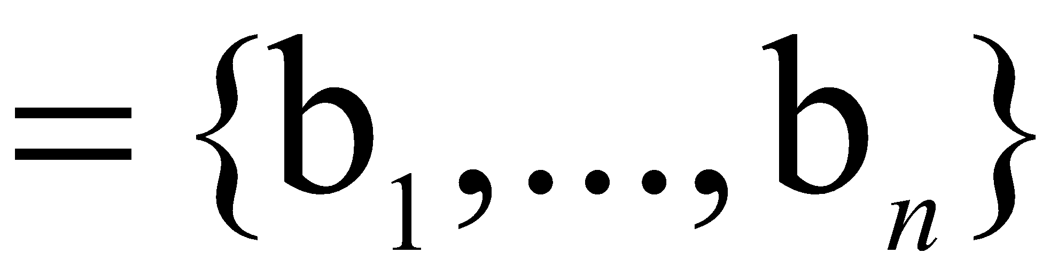
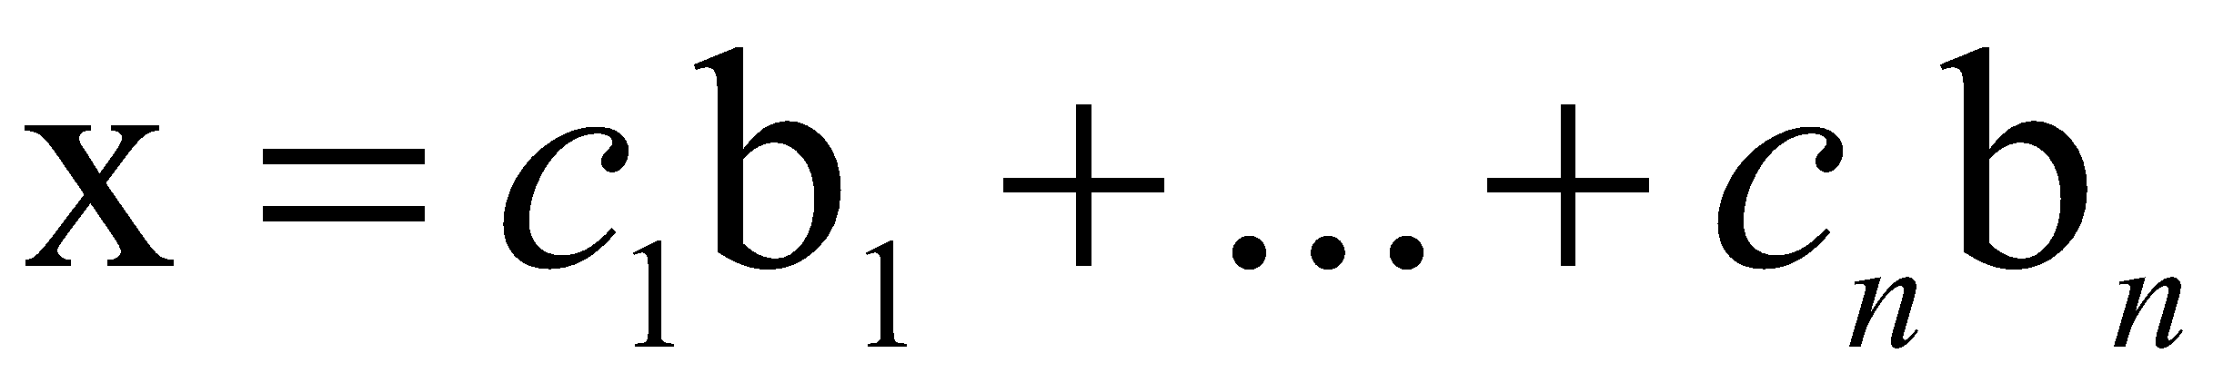
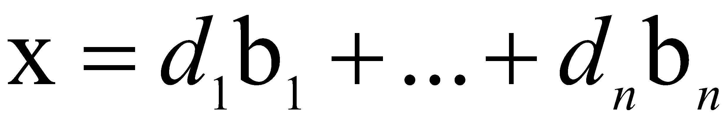
THE UNIQUE REPRESENTATION THEOREM
Theorem 7: Let B be a basis for vector space V. Then for each x in V, there exists a unique set of scalars c₁, …, c_{n} such that
(1)
Proof: Since B spans V, there exist scalars such that (1) holds.
Suppose x also has the representation
for scalars d₁, …, d_{n}.

Slide 5
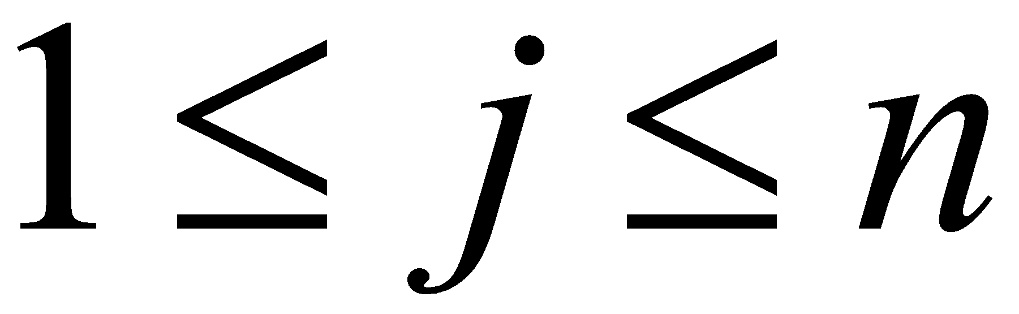
THE UNIQUE REPRESENTATION THEOREM
Then, subtracting, we have
(2)
Since B is linearly independent, the weights in (2) must all be zero. That is, for .
Definition: Suppose B is a basis for V and x is in V. The coordinates of x relative to the basis B (or the B-coordinate of x) are the weights c₁, …, c_{n} such that .

Slide 6
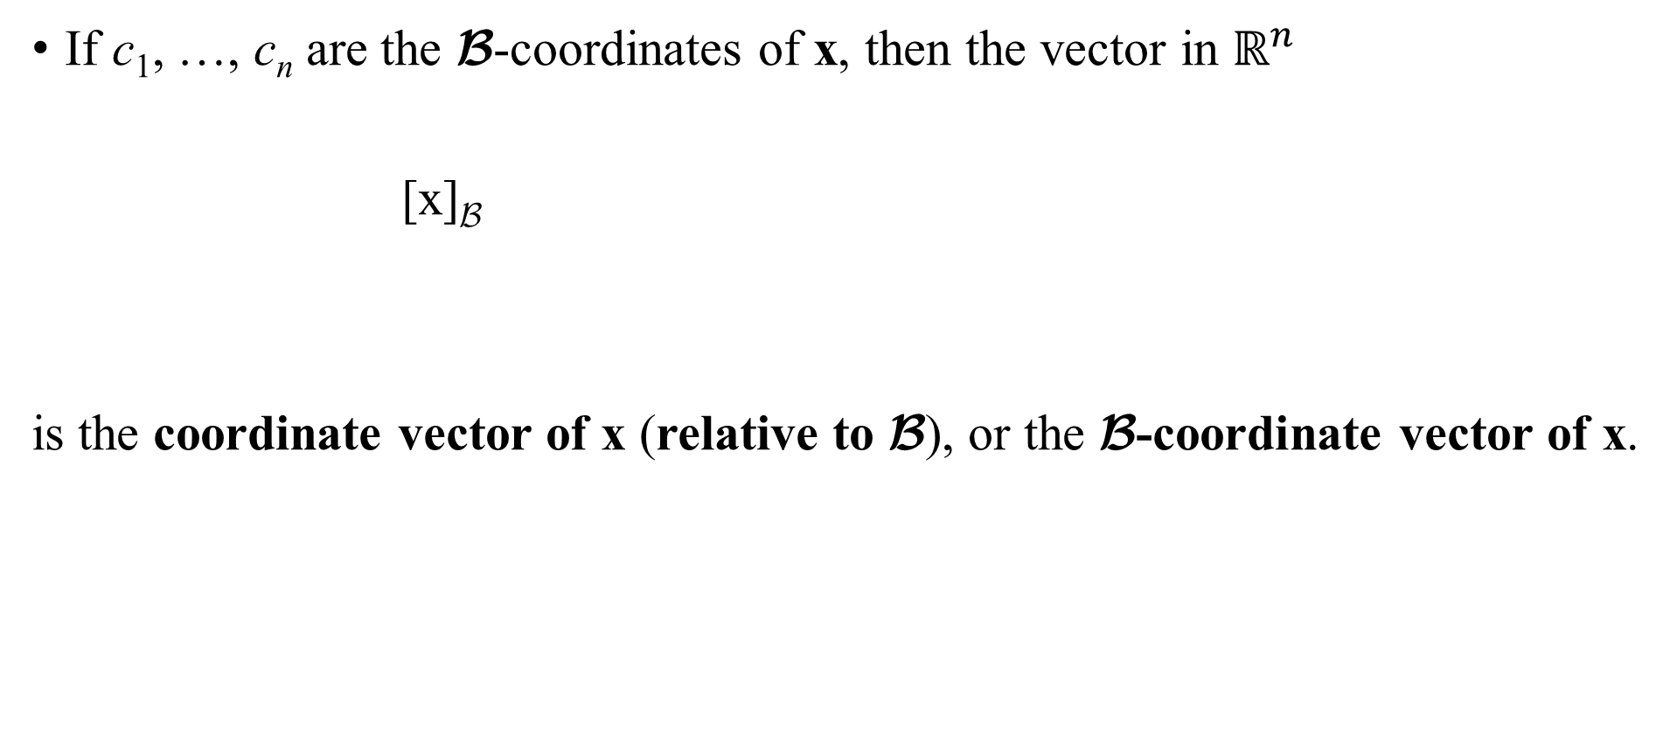
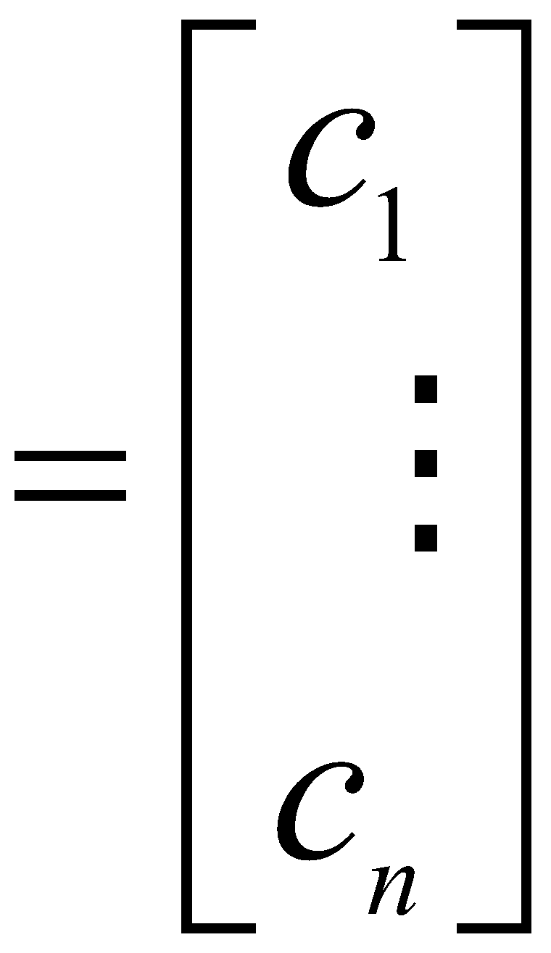
THE UNIQUE REPRESENTATION THEOREM

Slide 7
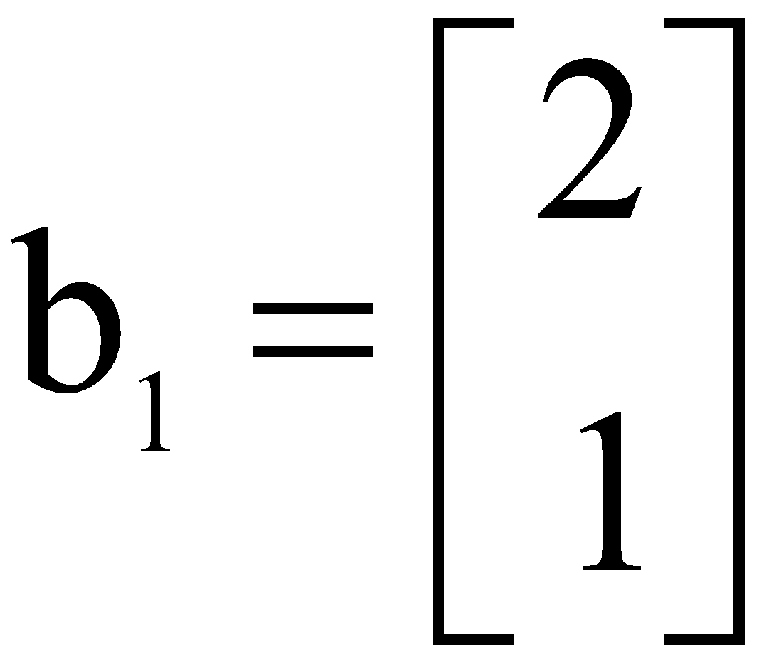
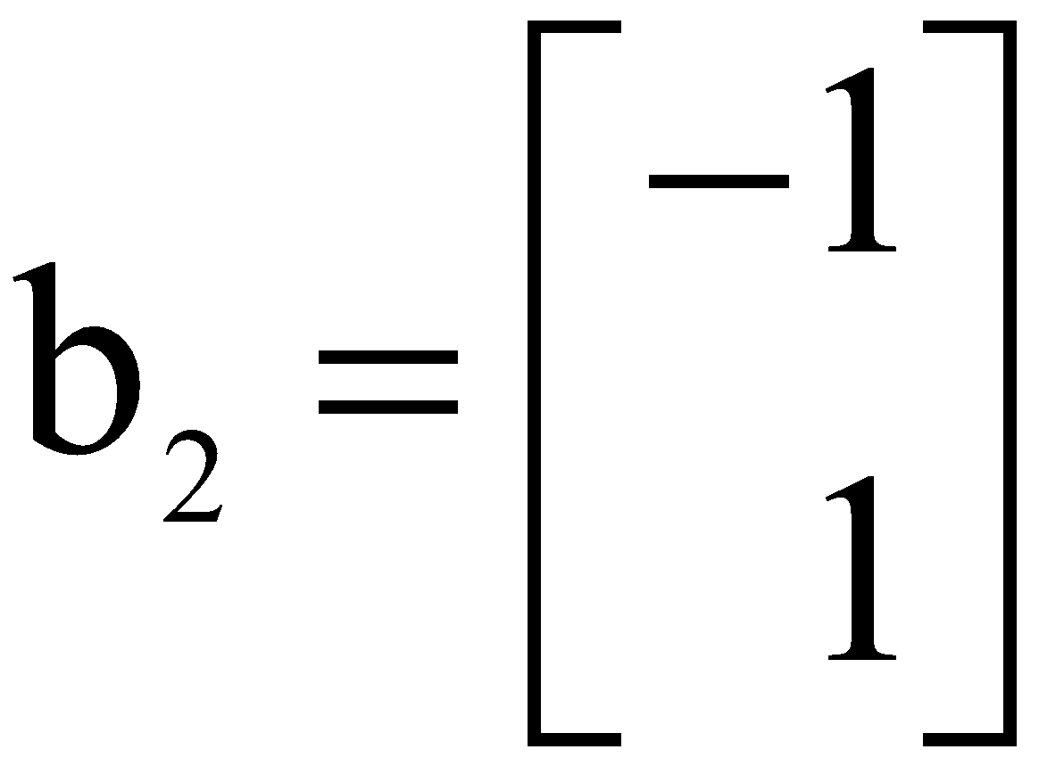
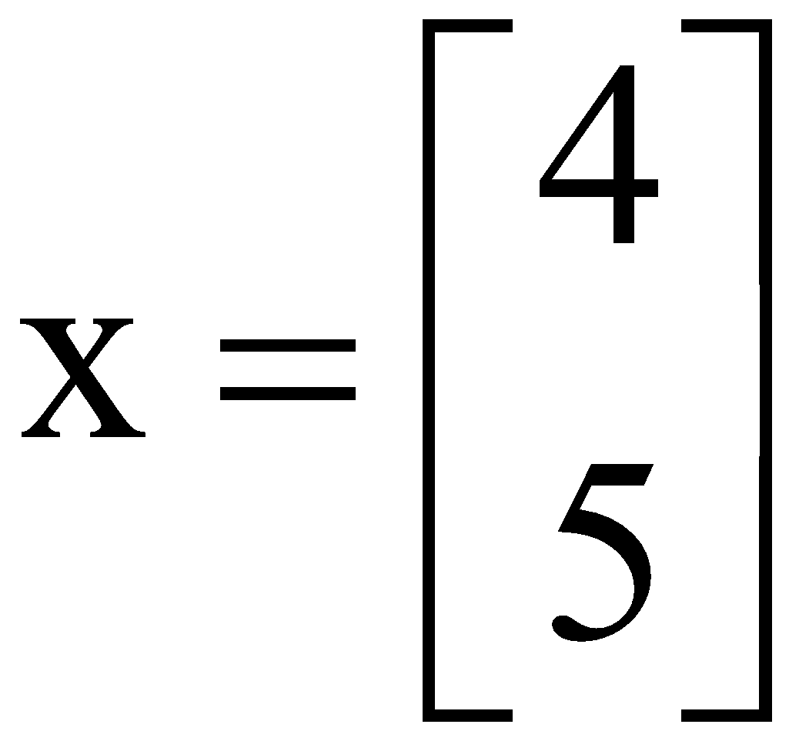
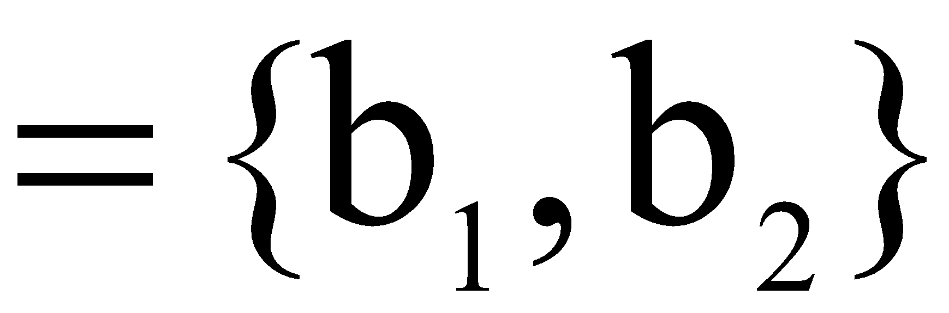
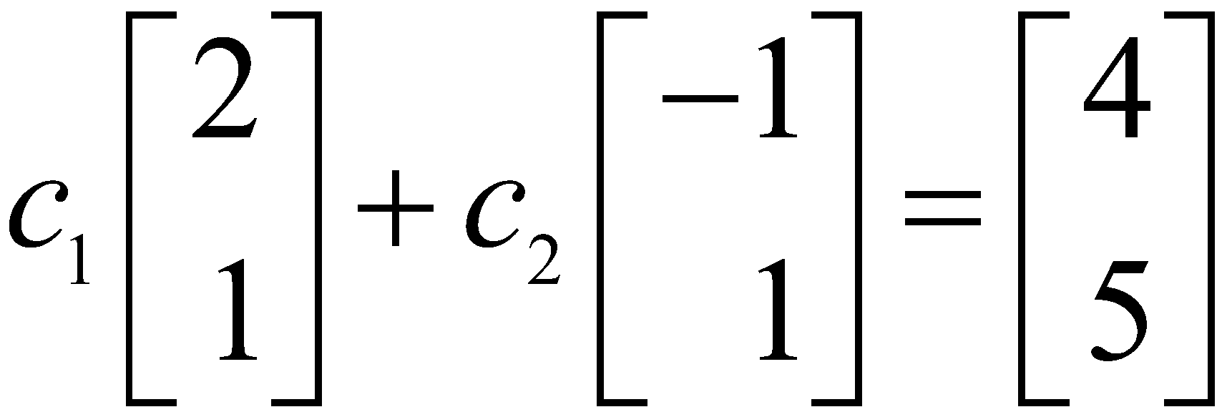
Example 1: Let , , , and
B . Find the coordinate vector [x]_{B} of x relative to B.
Solution: The B-coordinate c₁, c₂ of x satisfy

Slide 8
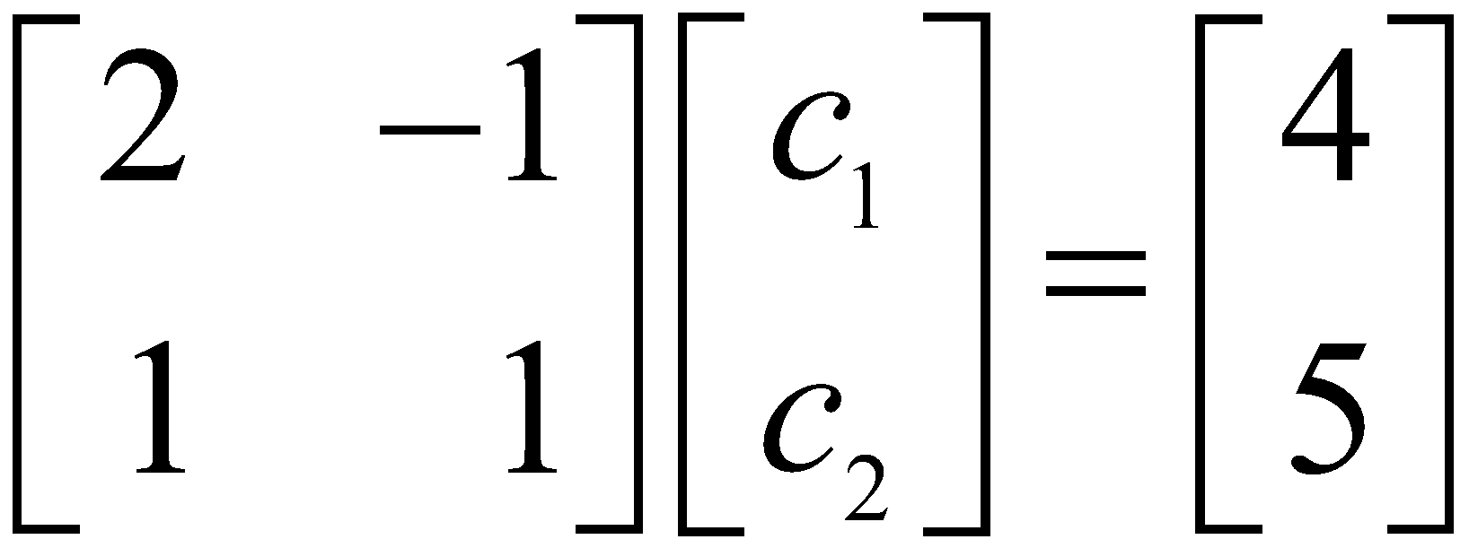
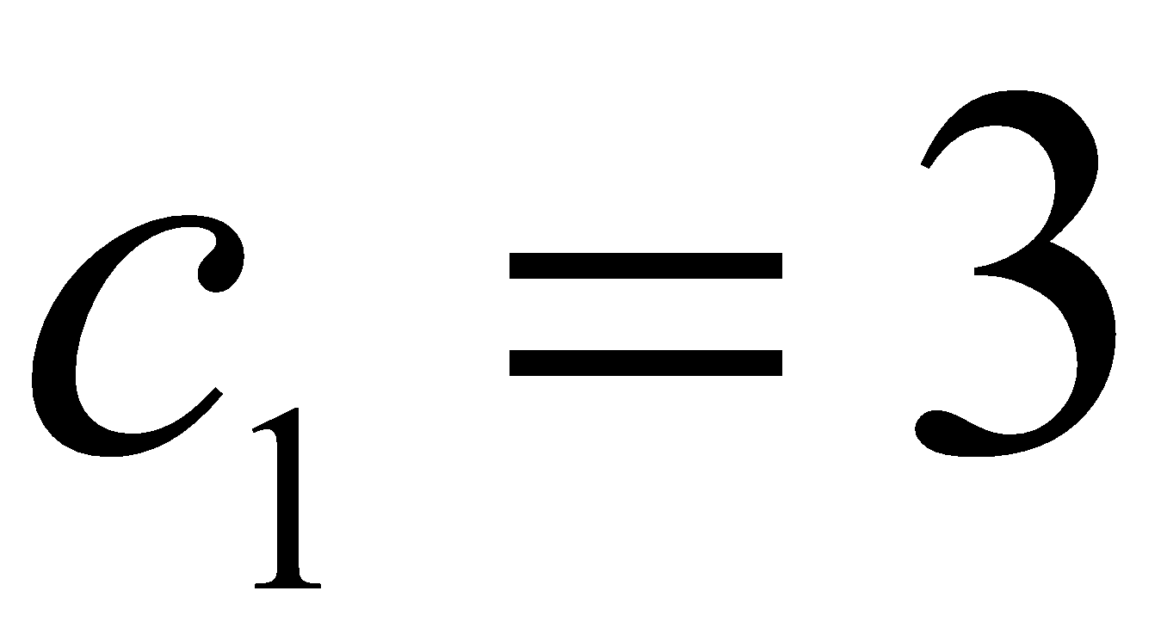
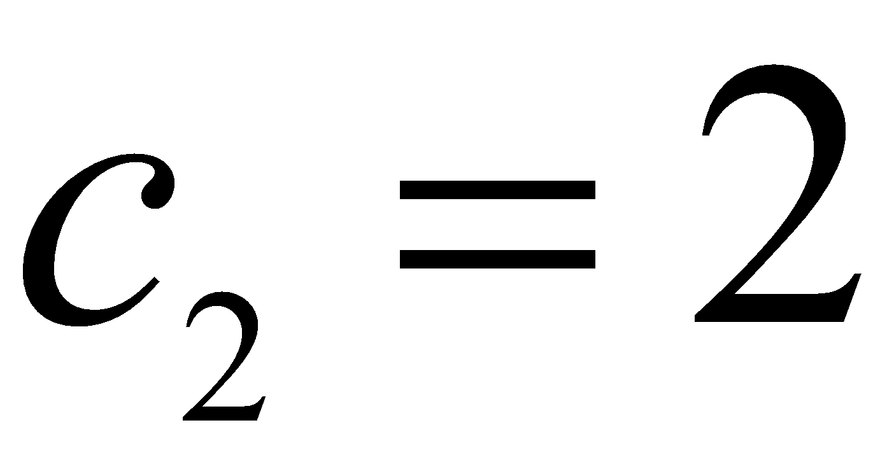
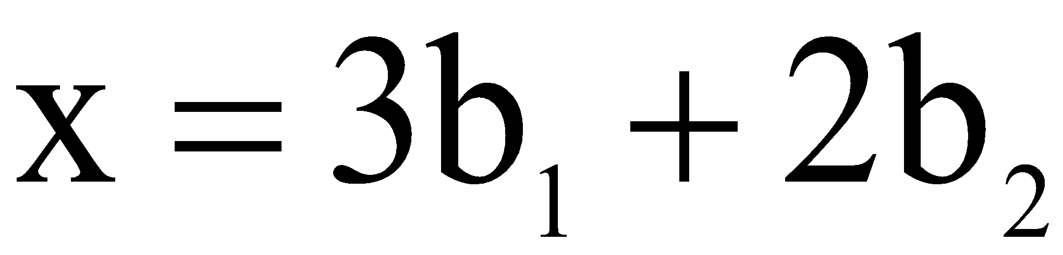
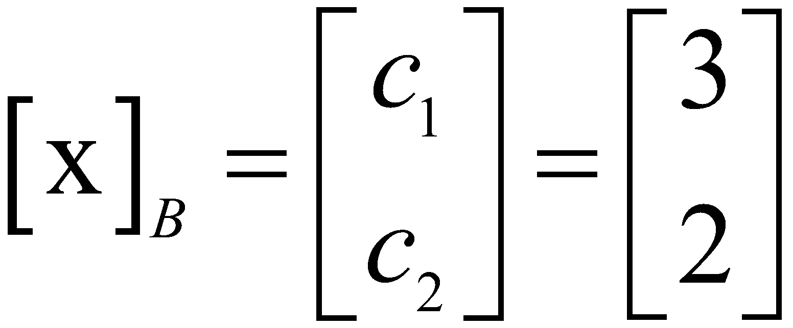
Or
(3)
This equation can be solved by row operations on an augmented matrix or by using the inverse of the matrix on the left.
In any case, the solution is , .
Thus and

Slide 9
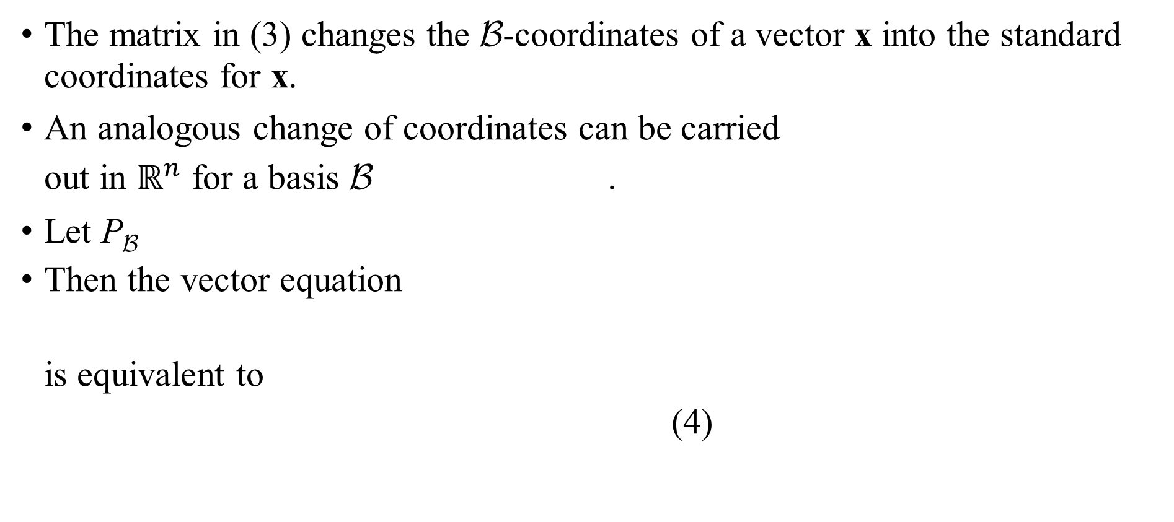
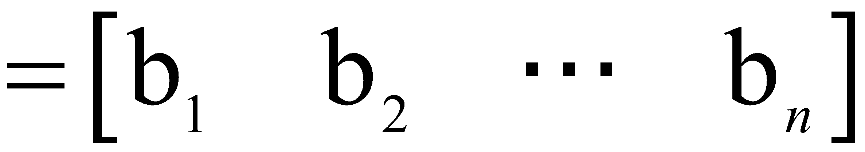
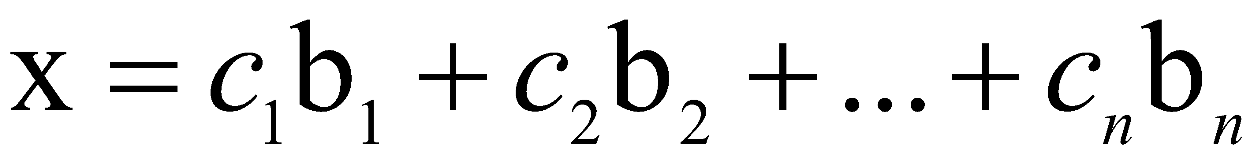
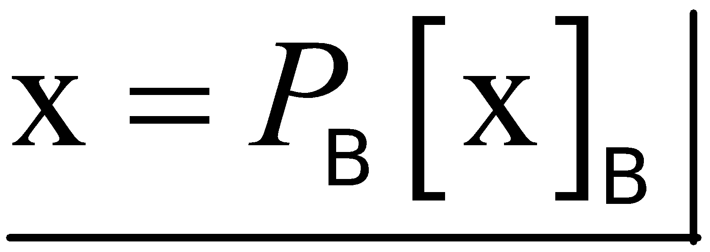

Slide 10
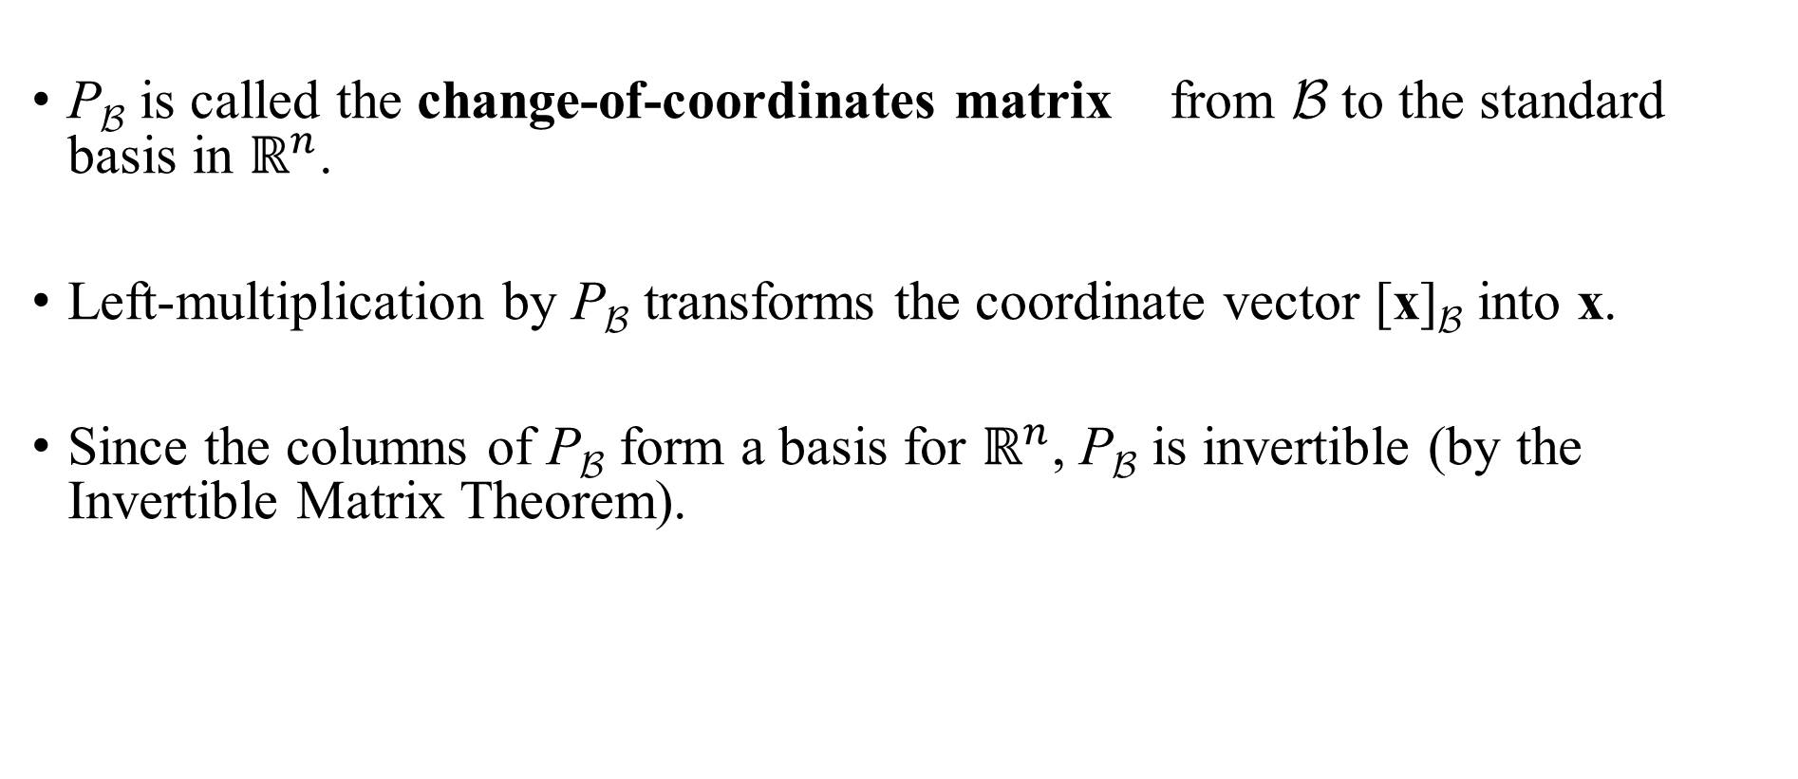

Slide 11
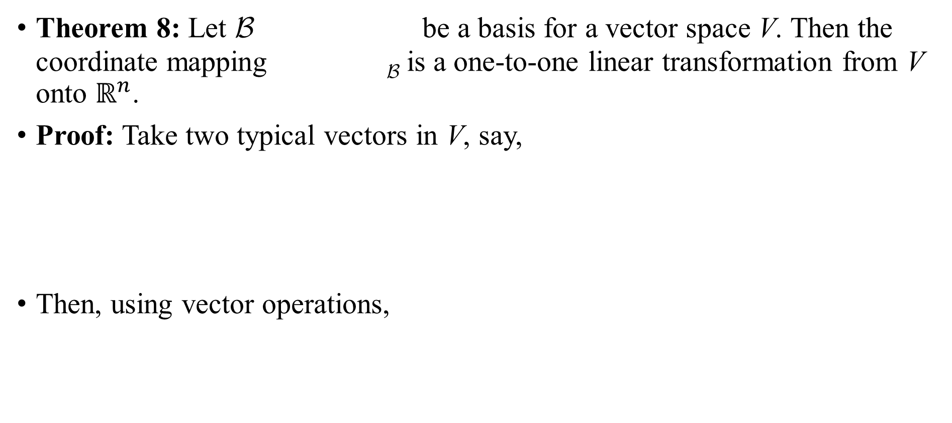

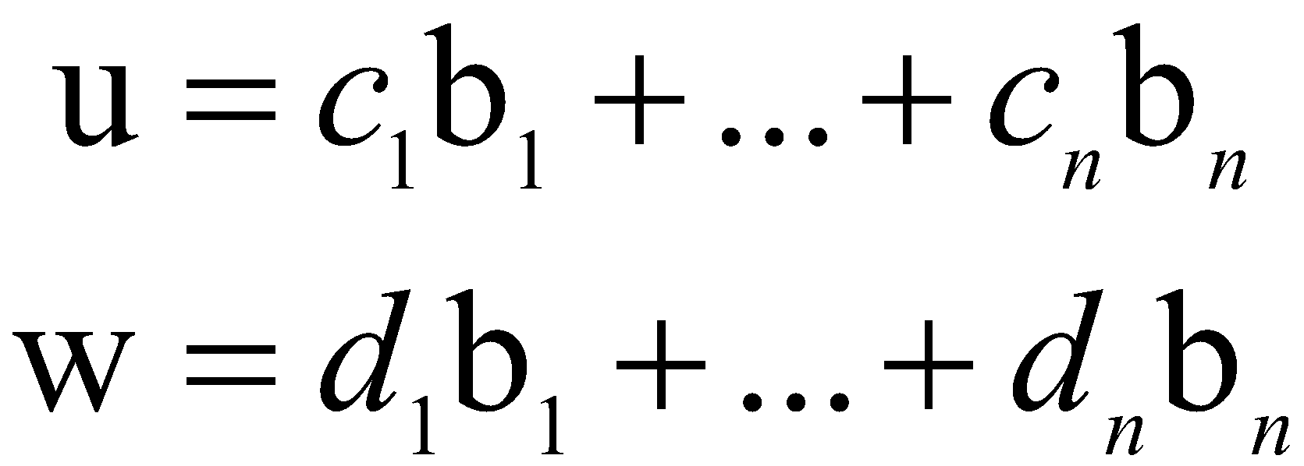
THE COORDINATE MAPPING

Slide 12
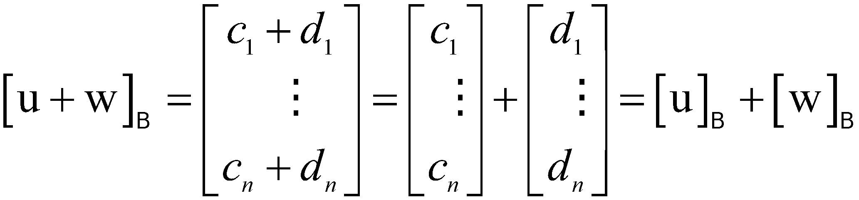
THE COORDINATE MAPPING
It follows that
So the coordinate mapping preserves addition.
If r is any scalar, then

Slide 13
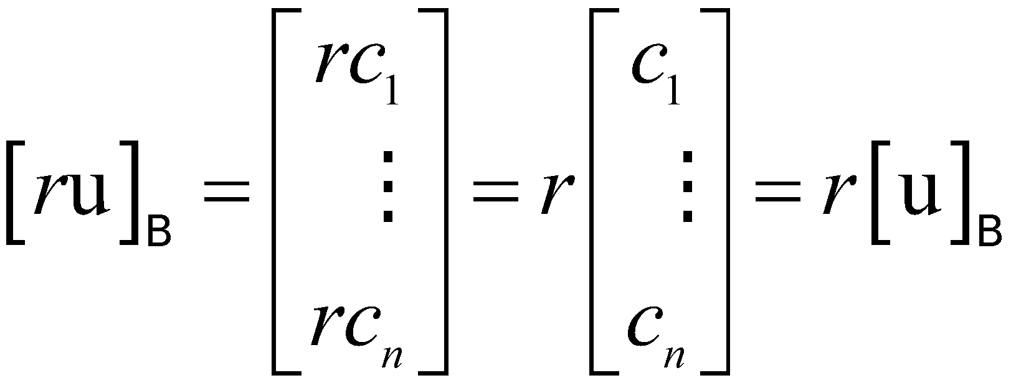
THE COORDINATE MAPPING
So
Thus the coordinate mapping also preserves scalar multiplication and hence is a linear transformation.
The linearity of the coordinate mapping extends to linear combinations.
If u₁, …, u_{p} are in V and if c₁, …, c_{p} are scalars, then
(5)

Slide 14
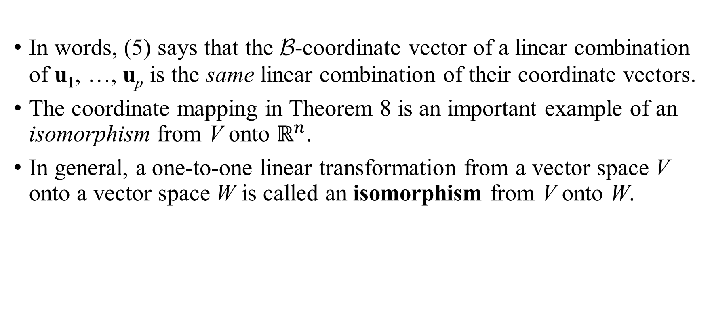
THE COORDINATE MAPPING

Slide 15
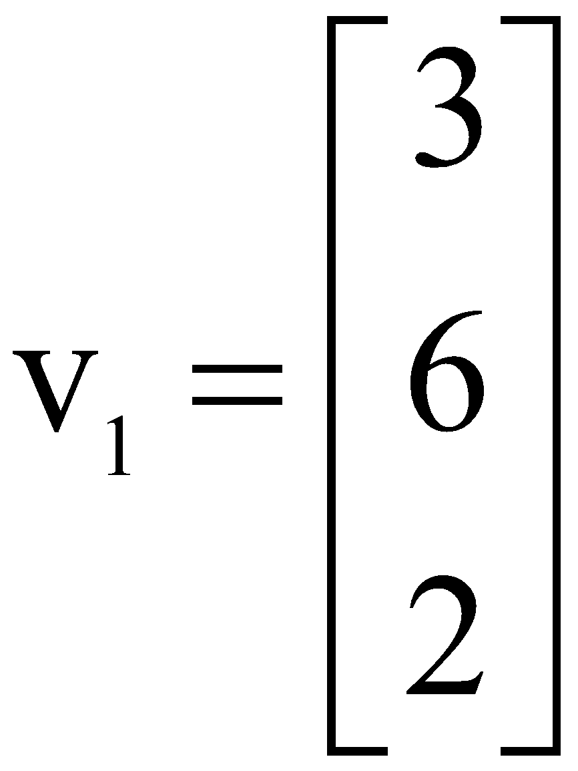
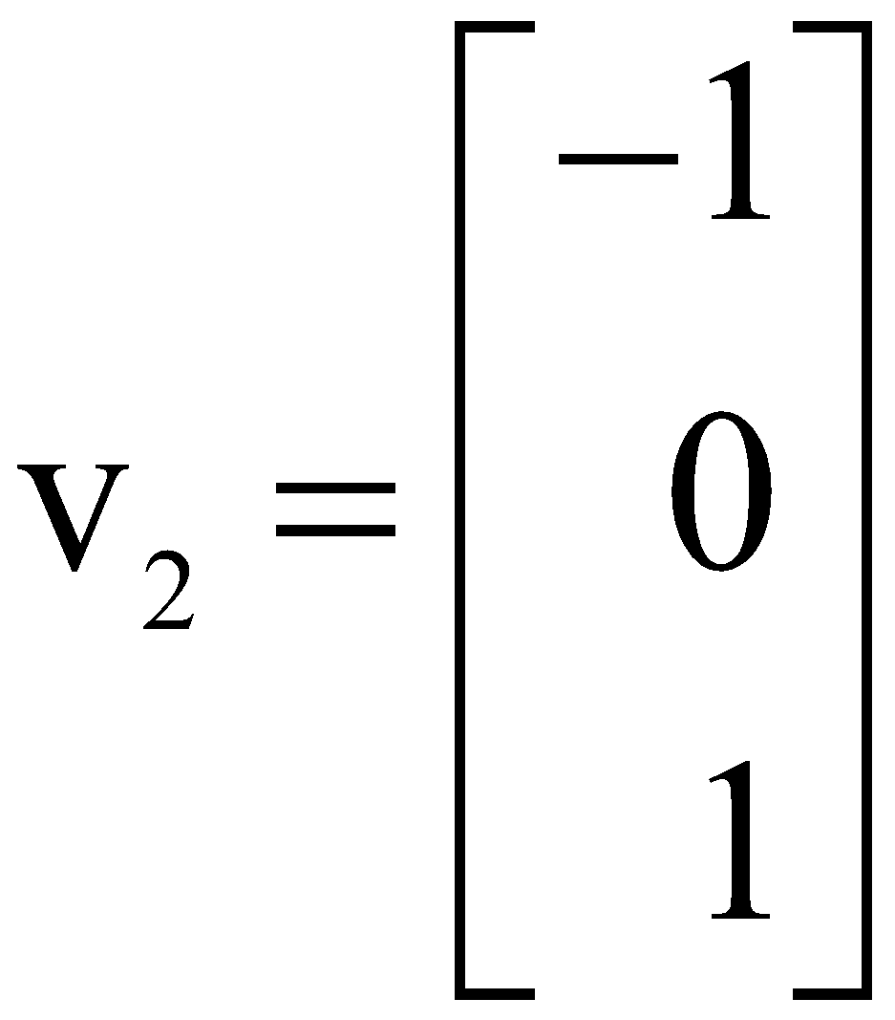
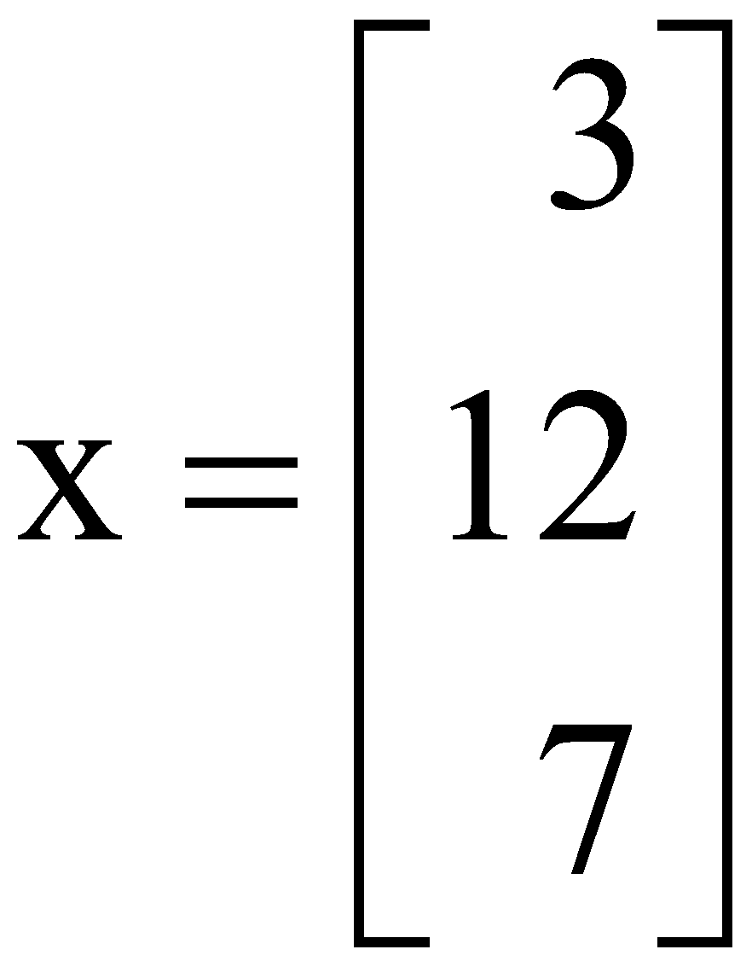
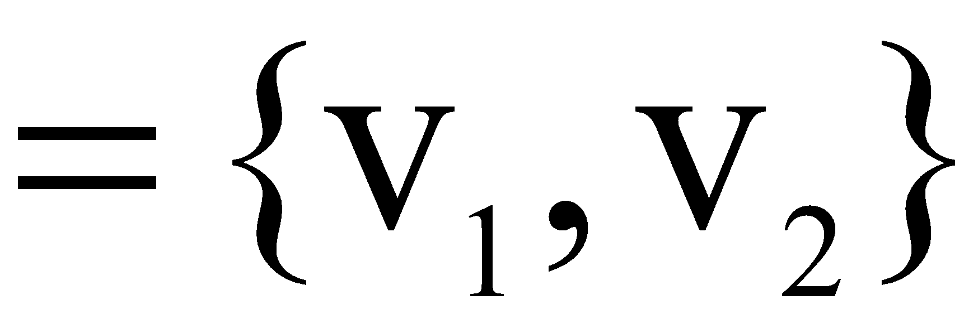
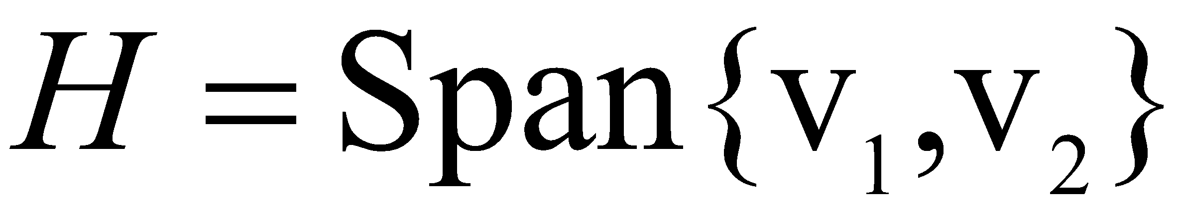
THE COORDINATE MAPPING
Example 7: Let , , ,
and B . Then B is a basis for
Determine if x is in H, and if it is, find the coordinate vector of x relative to B.

Slide 16
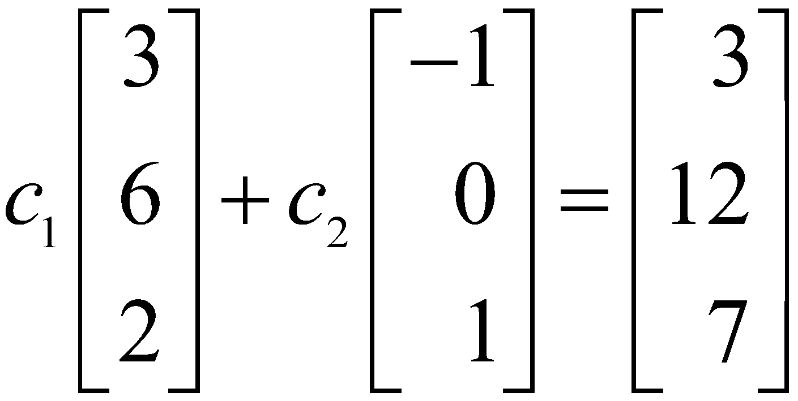
THE COORDINATE MAPPING
Solution: If x is in H, then the following vector equation is consistent:
The scalars c₁ and c₂, if they exist, are the B-coordinates of x.

Slide 17
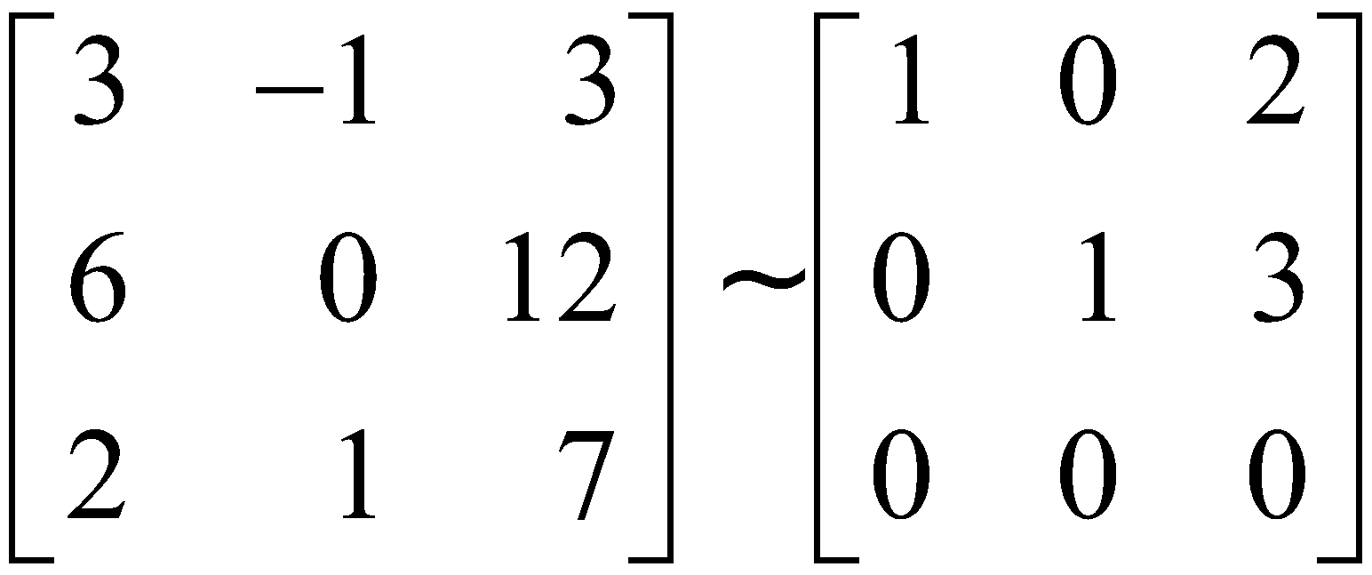
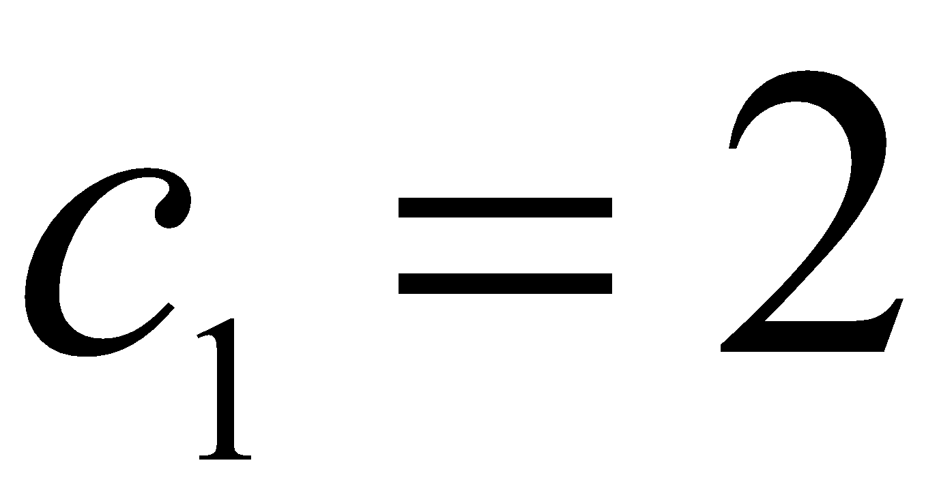
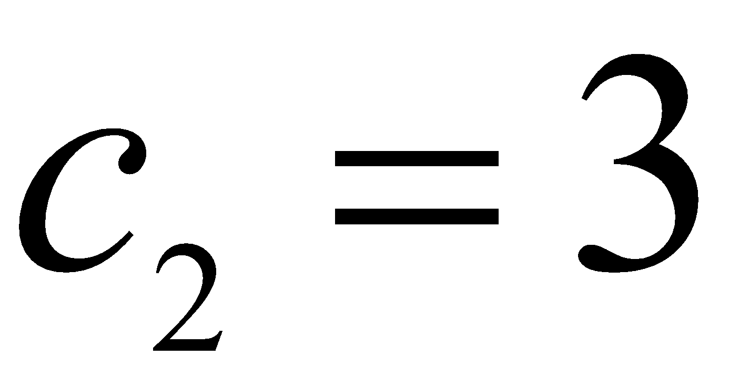
THE COORDINATE MAPPING
Using row operations, we obtain
Thus , and [x]_{B}

Slide 18
The Dimension of a
Vector Subspace

Slide 19
DIMENSION OF A VECTOR SPACE
Theorem 9: If a vector space V has a basis B , then any set in V containing more than n vectors must be linearly dependent.
Theorem 10: If a vector space V has a basis of n vectors, then every basis of V must consist of exactly n vectors.
Definition: If V is spanned by a finite set, then V is said to be finite-dimensional, and the dimension of V, written as dim V, is the number of vectors in a basis for V. The dimension of the zero vector space {0} is defined to be zero. If V is not spanned by a finite set, then V is said to be infinite-dimensional

Slide 20
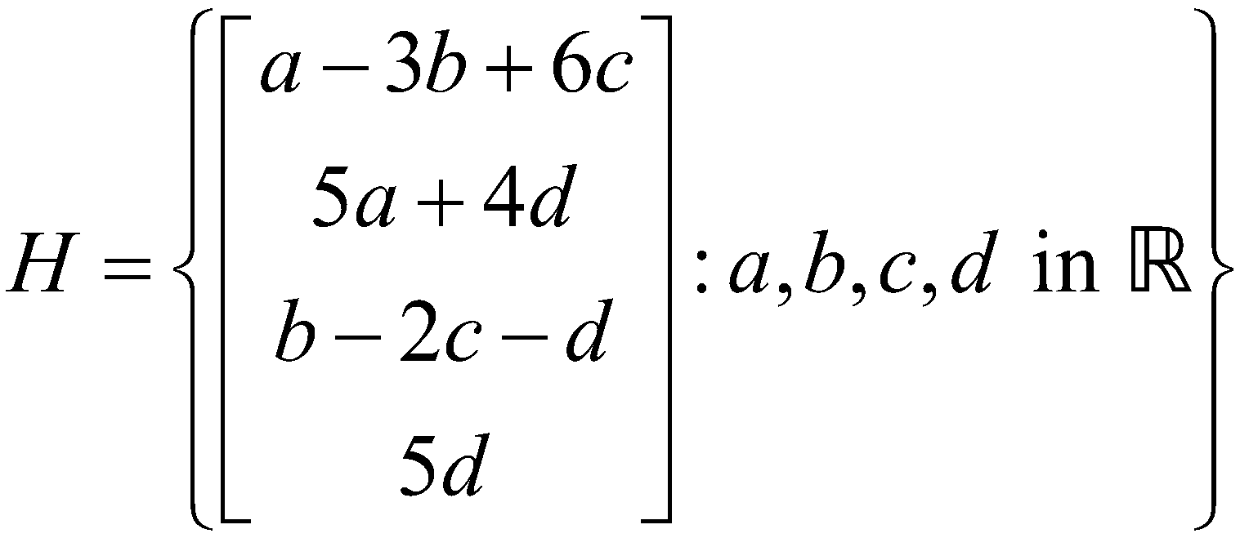
DIMENSION OF A VECTOR SPACE
Example 3: Find the dimension of the subspace
H is the set of all linear combinations of the vectors

Slide 21
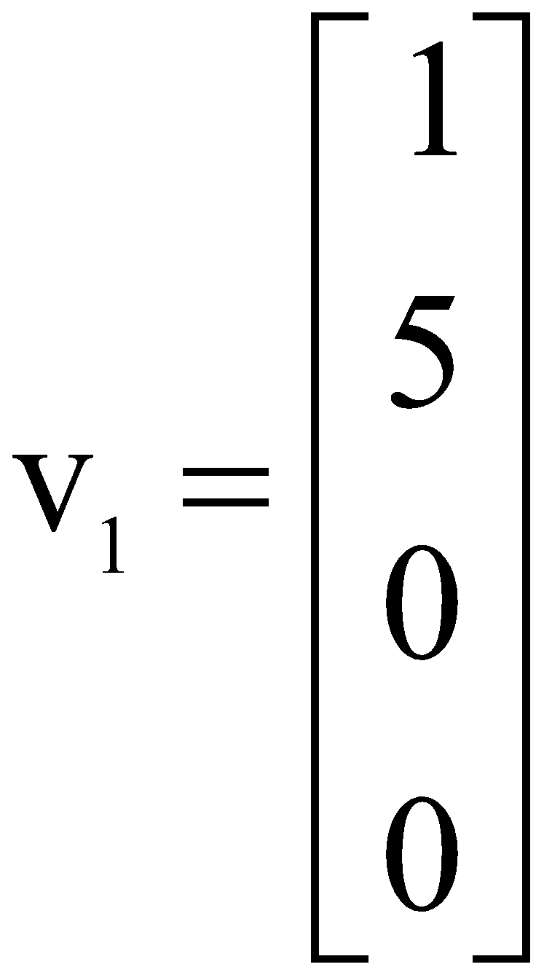
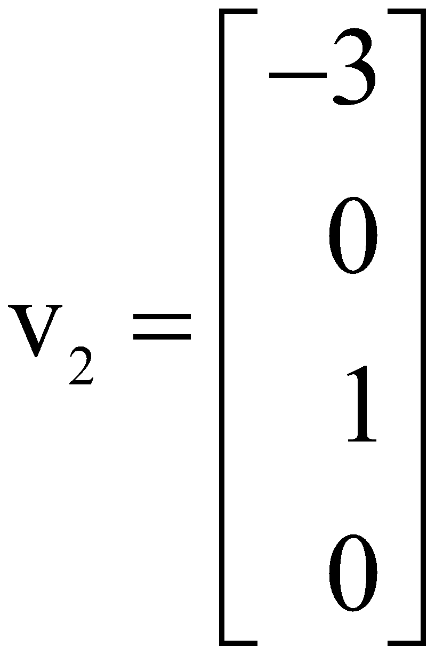
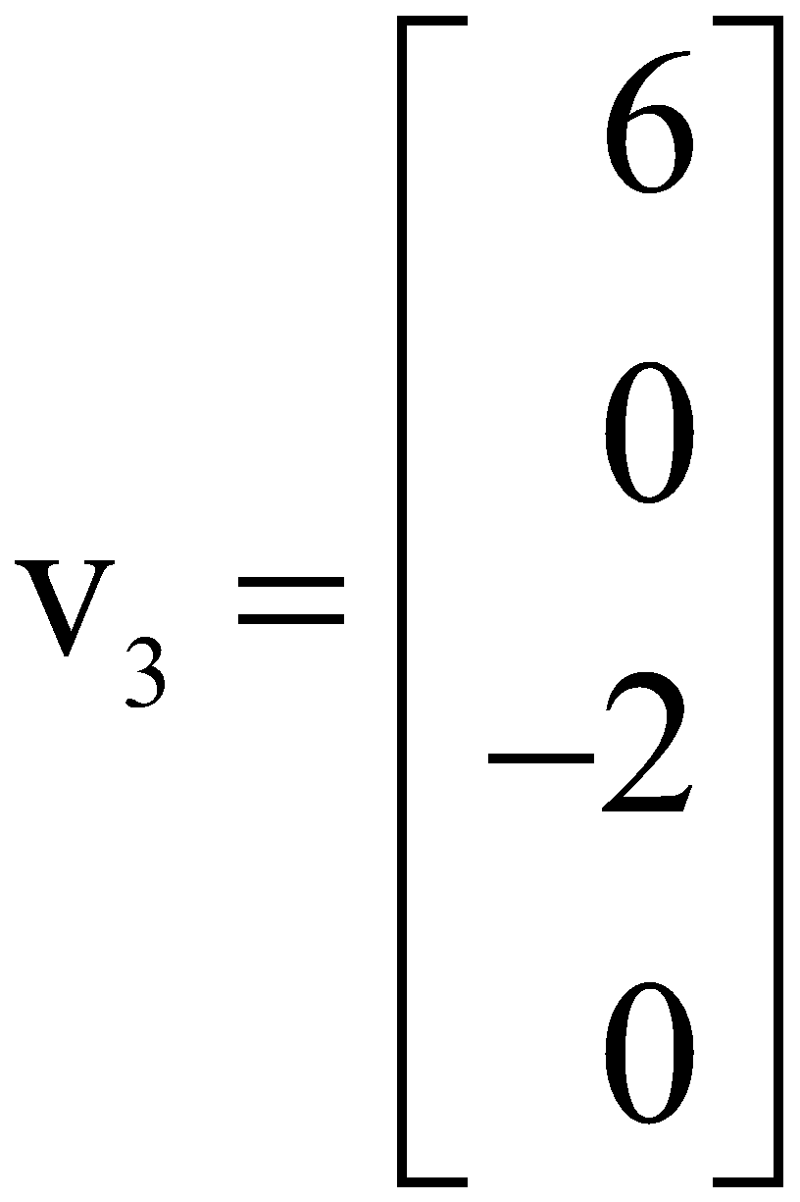
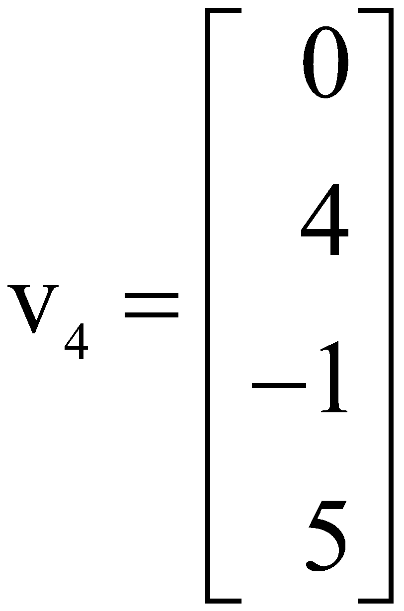
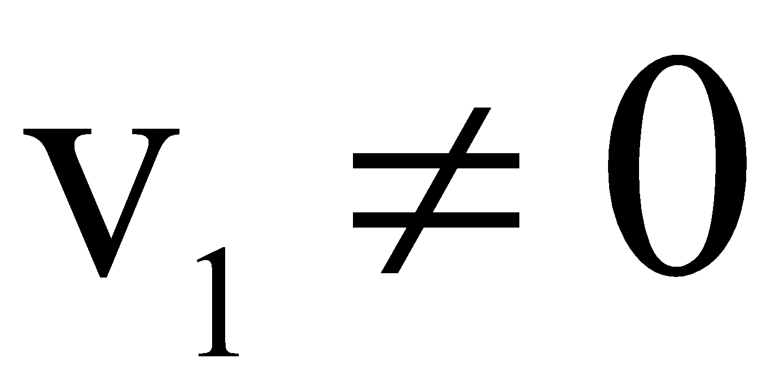
DIMENSION OF A VECTOR SPACE
Clearly, , v₂ is not a multiple of v₁, but v₃ is a multiple of v₂.
By the Spanning Set Theorem, we may discard v₃ and still have a set that spans H.

Slide 22

DIMENSION OF A VECTOR SPACE
Finally, v₄ is not a linear combination of v₁ and v₂.
So {v₁, v₂, v₄} is linearly independent and hence is a basis for H.
Thus dim H = 3
Theorem 11: Let H be a subspace of a finite-dimensional vector space V. Any linearly independent set in H can be expanded, if necessary, to a basis for H. Also, H is finite-dimensional and

Slide 23
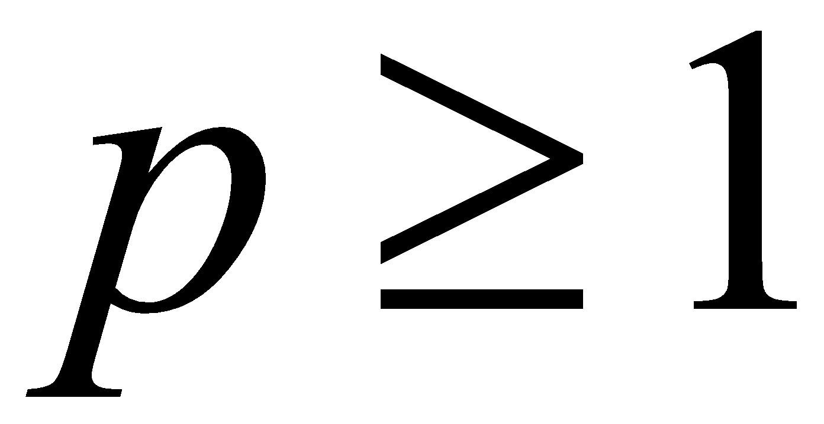
THE BASIS THEOREM
Theorem 12: Let V be a p-dimensional vector space, . Any linearly independent set of exactly p elements in V is automatically a basis for V. Any set of exactly p elements that spans V is automatically a basis for V.
Proof: By Theorem 11, a linearly independent set S of p elements can be extended to a basis for V.
But that basis must contain exactly p elements, since dim .
So S must already be a basis for V.

Slide 24

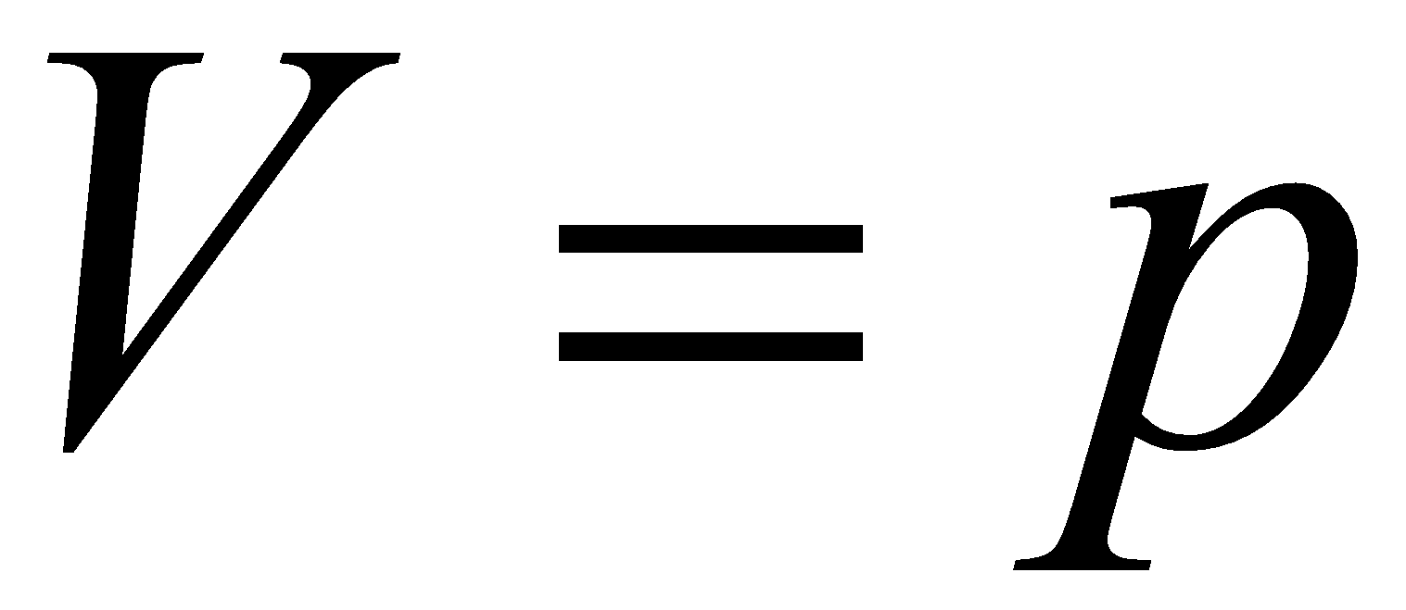

THE BASIS THEOREM
Now suppose that S has p elements and spans V.
Since V is nonzero, the Spanning Set Theorem implies that a subset
of S is a basis of V.
Since dim , must contain p vectors.
Hence .

Slide 25

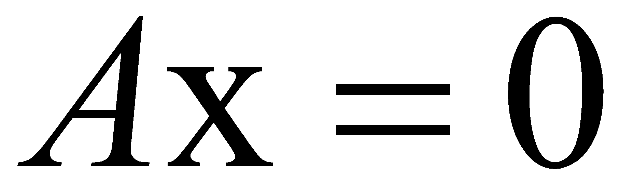
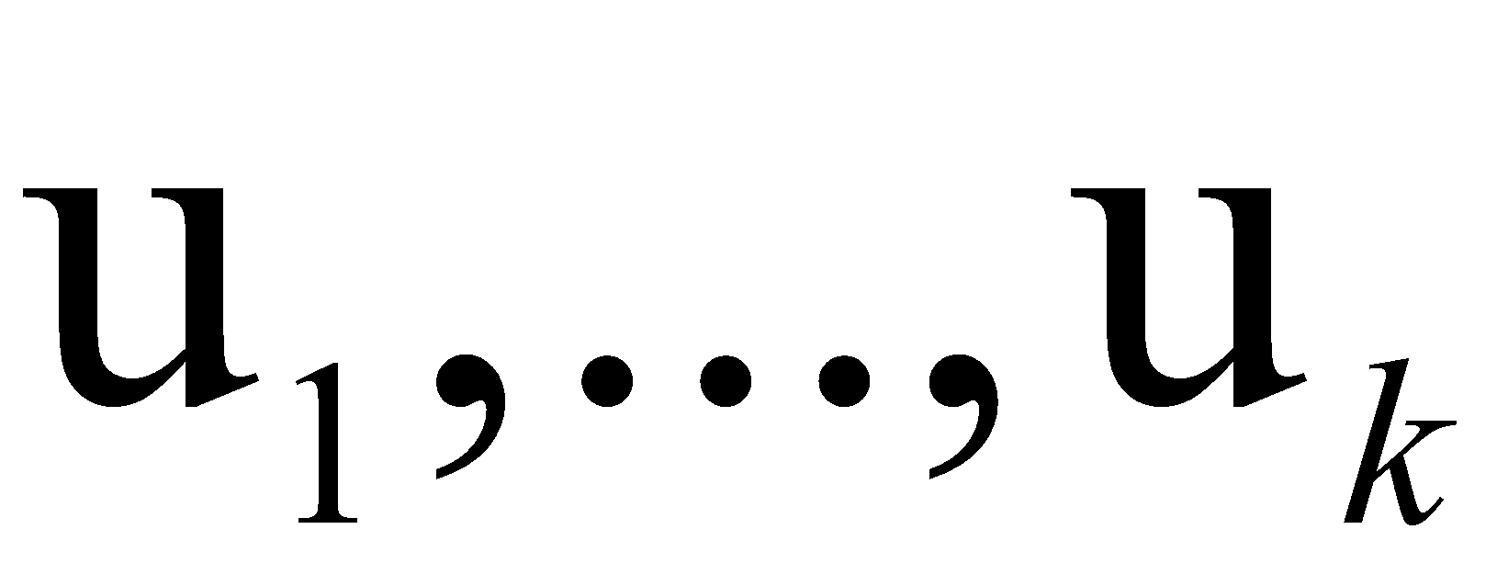

THE DIMENSIONS OF NUL A AND COL A
Let A be an matrix, and suppose the equation
has k free variables.
A spanning set for Nul A will produce exactly k linearly independent vectors—say, one for each free variable.
So is a basis for Nul A, and the number of free variables determines the size of the basis.

Slide 26
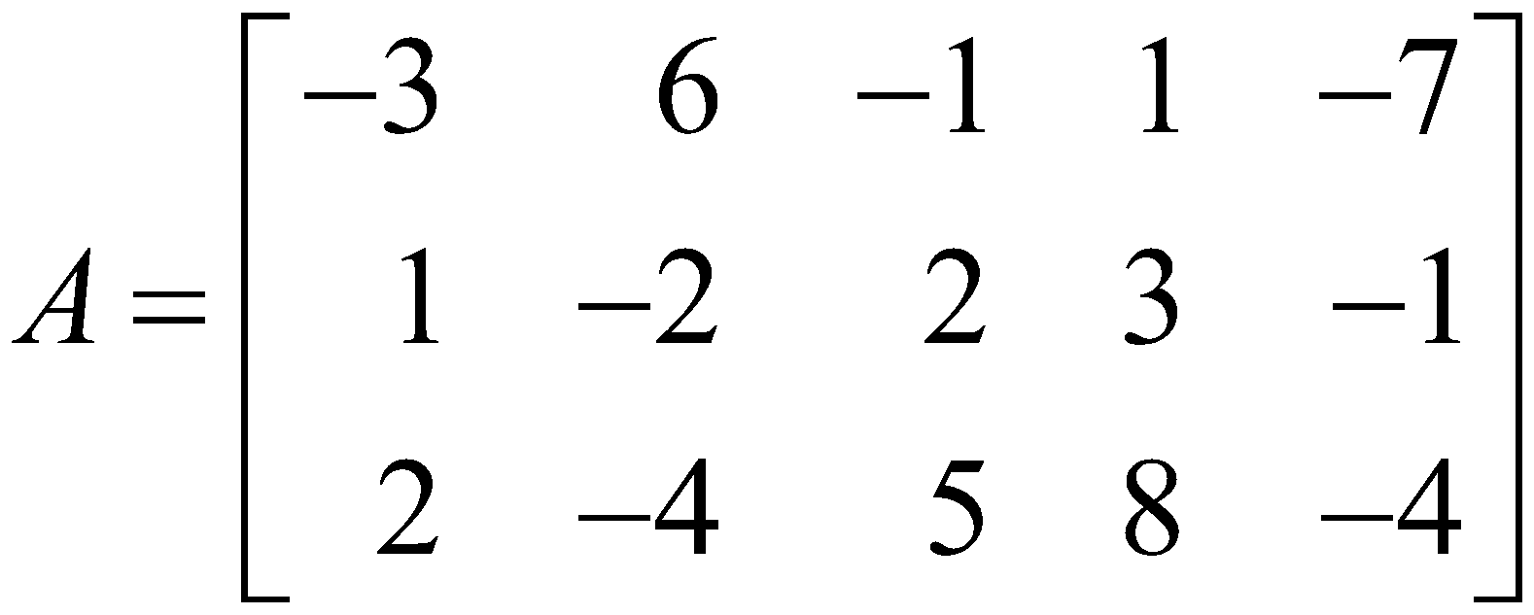
THE DIMENSIONS OF NUL A AND COL A
Thus, the dimension of Nul A is the number of free variables in the equation , and the dimension of Col A is the number of pivot columns in A.
Example 5: Find the dimensions of the null space and the column space of

Slide 27

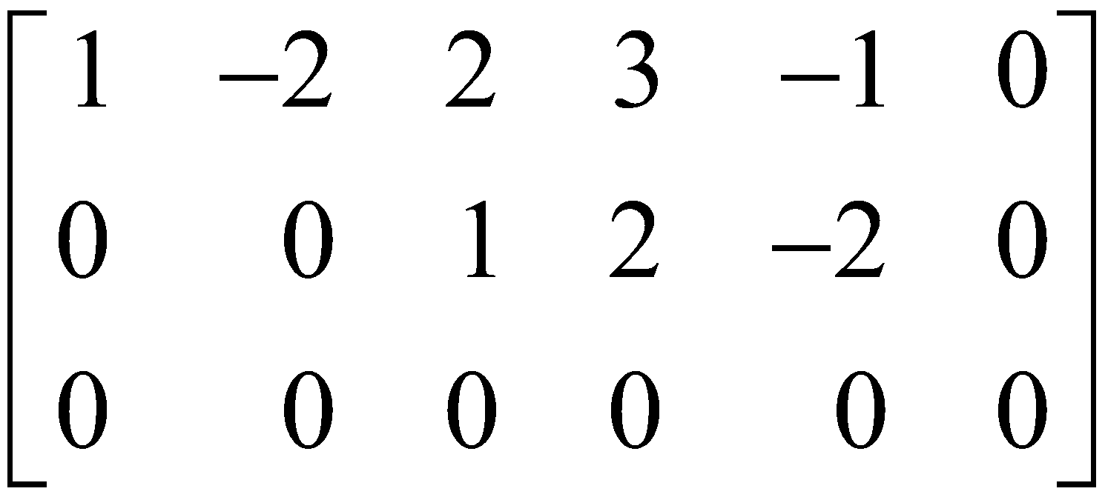

THE DIMENSIONS OF NUL A AND COL A
Solution: Row reduce the augmented matrix to echelon form:
There are three free variable—x₂, x₄ and x₅.
Hence the dimension of Nul A is 3.
Also dim Col because A has two pivot columns.

Slide 28
Rank

Slide 29
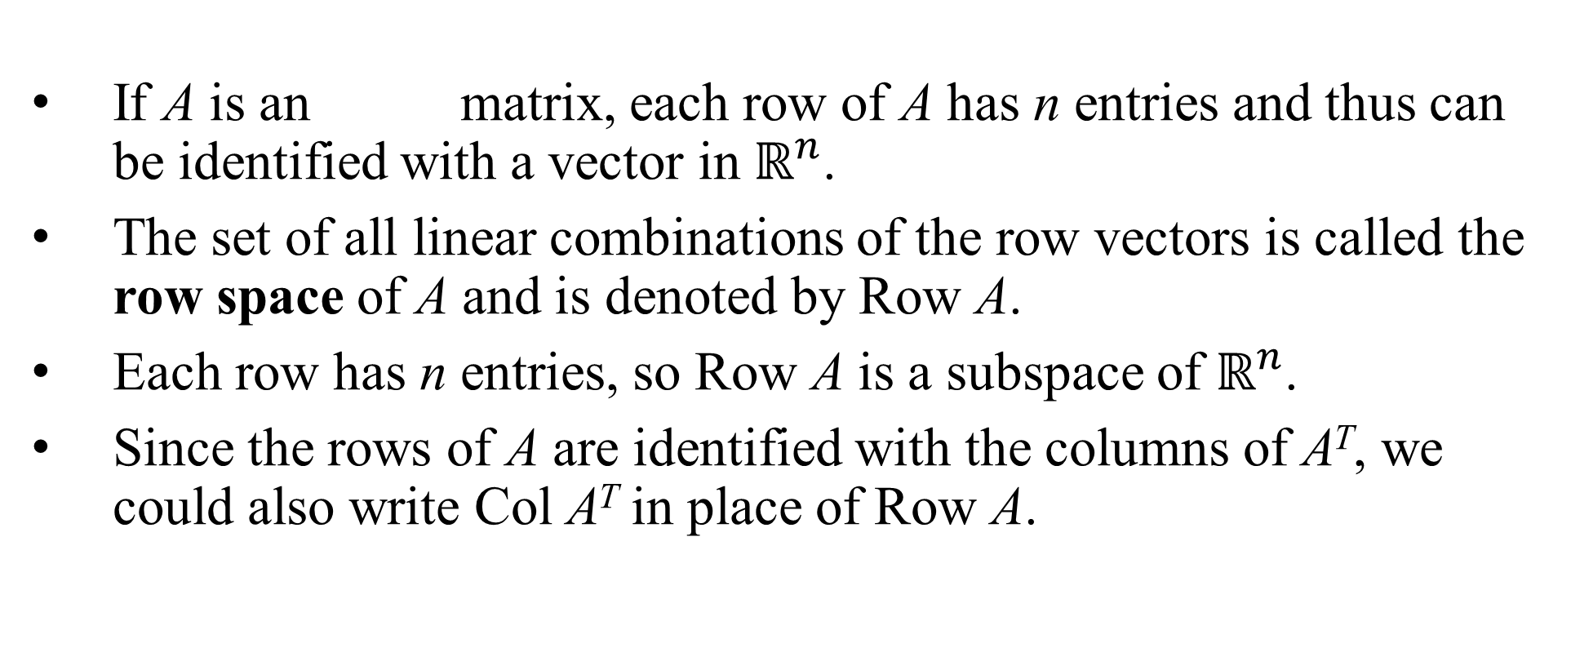
THE ROW SPACE

Slide 30
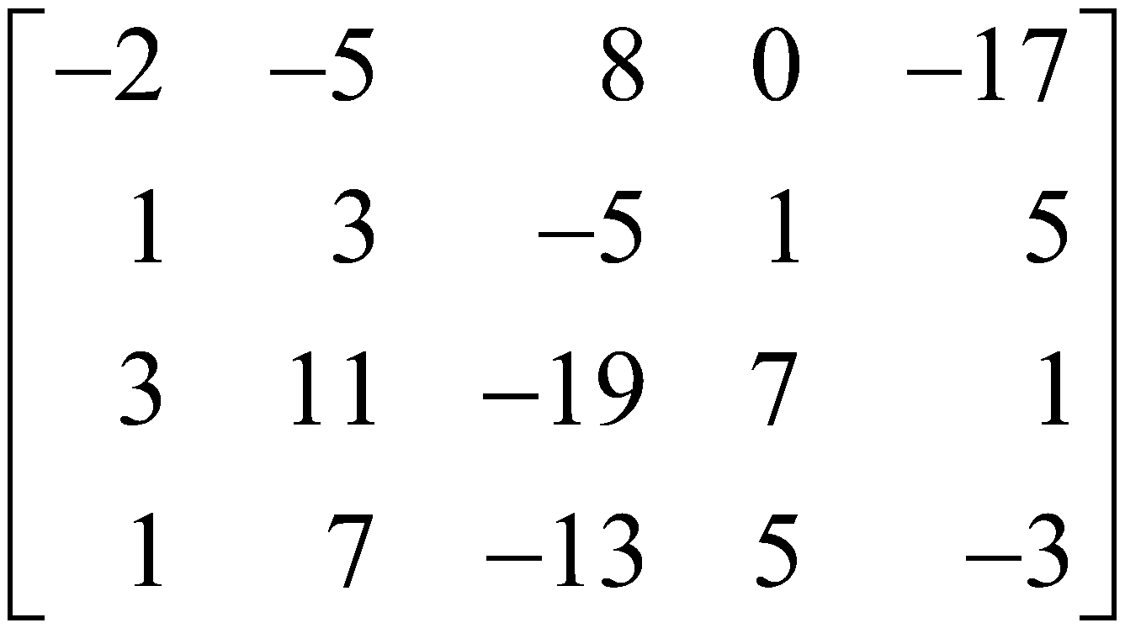
THE ROW SPACE
Theorem 13: If two matrices A and B are row equivalent, then their row spaces are the same. If B is in echelon form, the nonzero rows of B form a basis for the row space of A as well as for that of B.
Example 2: Find bases for the row space, the column space, and the null space of the matrix

Slide 31
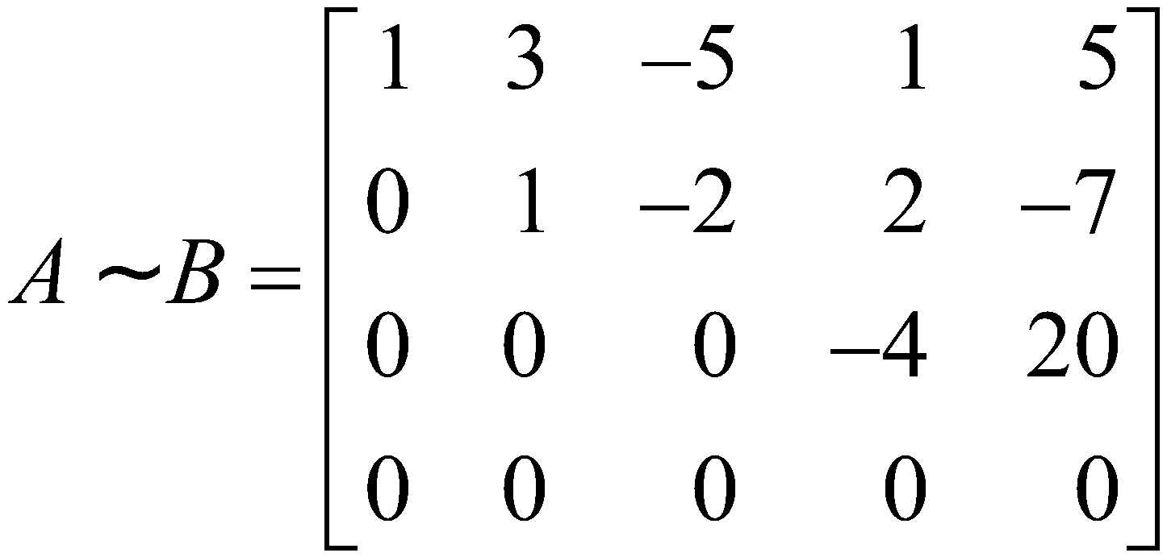
THE ROW SPACE
Solution: To find bases for the row space and the column space, row reduce A to an echelon form:
By Theorem 13, the first three rows of B form a basis for the row space of A (as well as for the row space of B).

Slide 32

THE ROW SPACE
Thus
Basis for Row
For the column space, observe from B that the pivots are in columns 1, 2, and 4.
Hence columns 1, 2, and 4 of A (not B) form a basis for Col A:
Basis for Col

Slide 33

THE ROW SPACE
Notice that any echelon form of A provides (in its nonzero rows) a basis for Row A and also identifies the pivot columns of A for Col A.
However, for Nul A, we need the reduced echelon form.
Further row operations on B yield

Slide 34




THE ROW SPACE
The equation Ax = 0 is equivalent to Cx = 0 , that is,
So , , , with x₃ and x₅ free variables.
The calculations show that

Slide 35

THE ROW SPACE
Basis for Nul
Observe that, unlike the basis for Col A, the bases for Row A and Nul A have no simple connection with the entries in A itself.

Slide 36
The Rank Theorem
Definition: The rank of A is the dimension of the column space of A.
Since Row A is the same as Col A^{T}, the dimension of the row space of A is the rank of A^{T}.
The dimension of the null space is sometimes called the nullity of A.
Theorem 14: The dimensions of the column space and the row space of an matrix A are equal. This common dimension, the rank of A, also equals the number of pivot positions in A and satisfies the equation

Slide 37




The Rank Theorem
Example 3:
If A is a matrix with a two-dimensional null space, what is the rank of A?
Could a matrix have a two-dimensional null space?
Solution:
Since A has 9 columns, , and hence rank .
No. If a matrix, call it B, has a two-dimensional null space, it would have to have rank 7, by the Rank Theorem

Slide 38






THE INVERTIBLE MATRIX THEOREM (CONTINUED)

Slide 39
Change Of Basis

Slide 40

Change Of Basis

Slide 41

Change Of Basis

Slide 42

Change Of Basis

Slide 43

Change Of Basis

Slide 44


Change Of Basis

Slide 45

Change Of Basis

Slide 46

Change Of Basis

Slide 47
Thank you for listening

